Slide 1

FINAL PRESENTATION SSD PROJECT
COLOUR BLINDNESS DETECTION USING A-Frame
Notes:
<number>

Slide 2
INTRODUCTION
Team Number SSD13
Sai Sirisha Nadiminti
Devershi Chandra
Pawan Patidar
Vishal Patel
Notes:
Group members names - Colour blindness detection using Aframe

Slide 3
PROBLEM DESCRIPTION

Slide 4
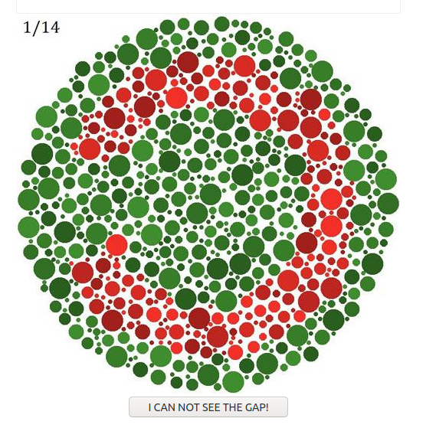
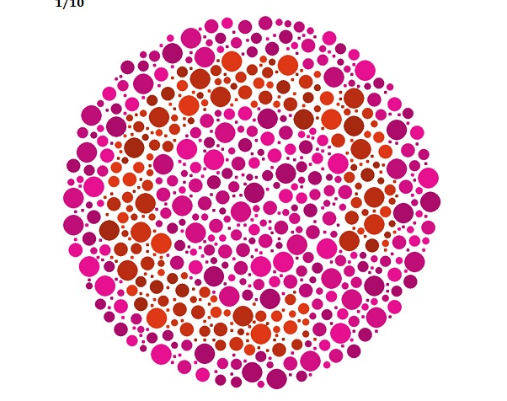
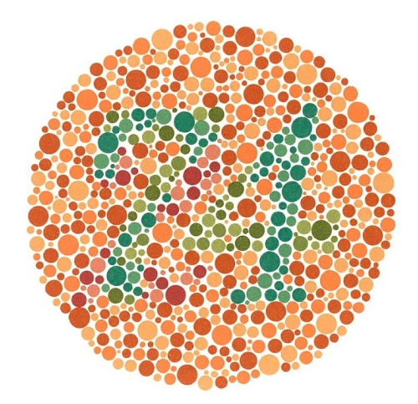
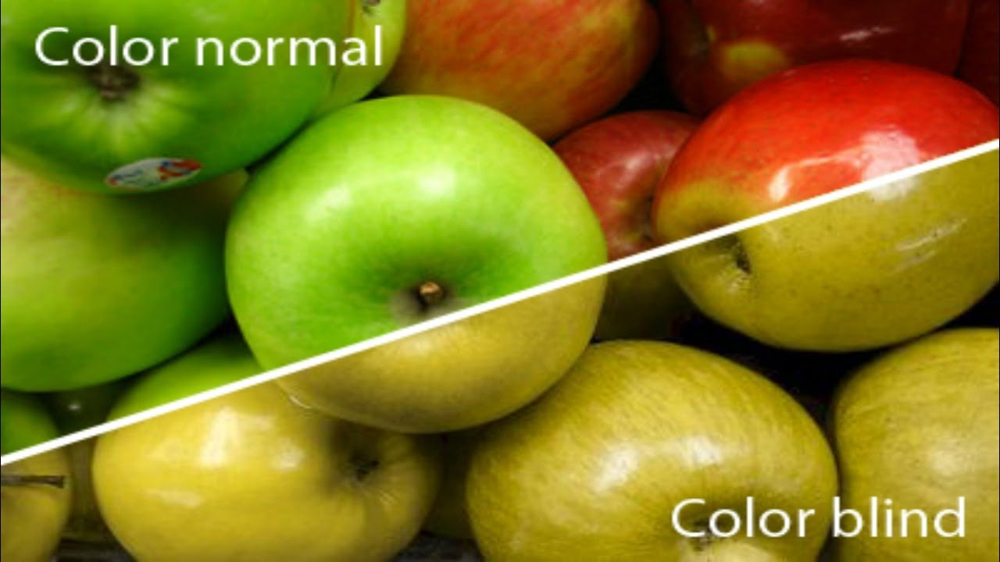
COLOUR BLINDNESS
Notes:
Mark Zuckerberg
<number>

Slide 5
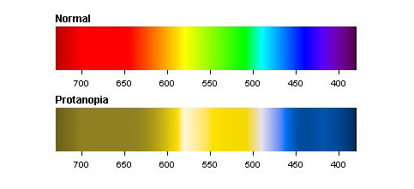
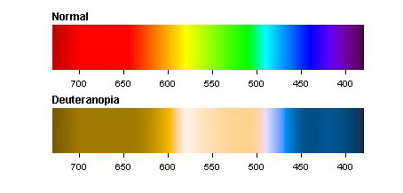
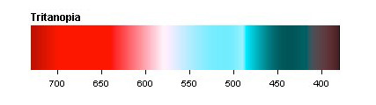
SOLUTION APPROACH
Exact type of colour blindness
Score system
Better user experience
More interactive
Notes:
Based on the perception of the user towards colours. Is he able to distinguish between the colours? Using aframe - better user experience, more interactive

Slide 6



TECHNICAL DETAILS
Notes:
AFrame library
HTML Javascript

Slide 7
DEMO

Slide 8
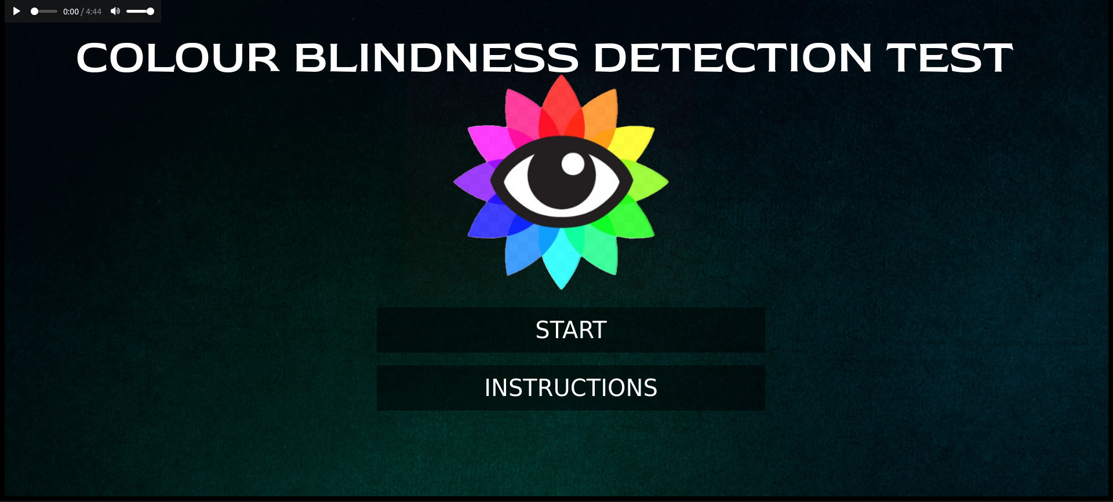
Notes:
<number>

Slide 9
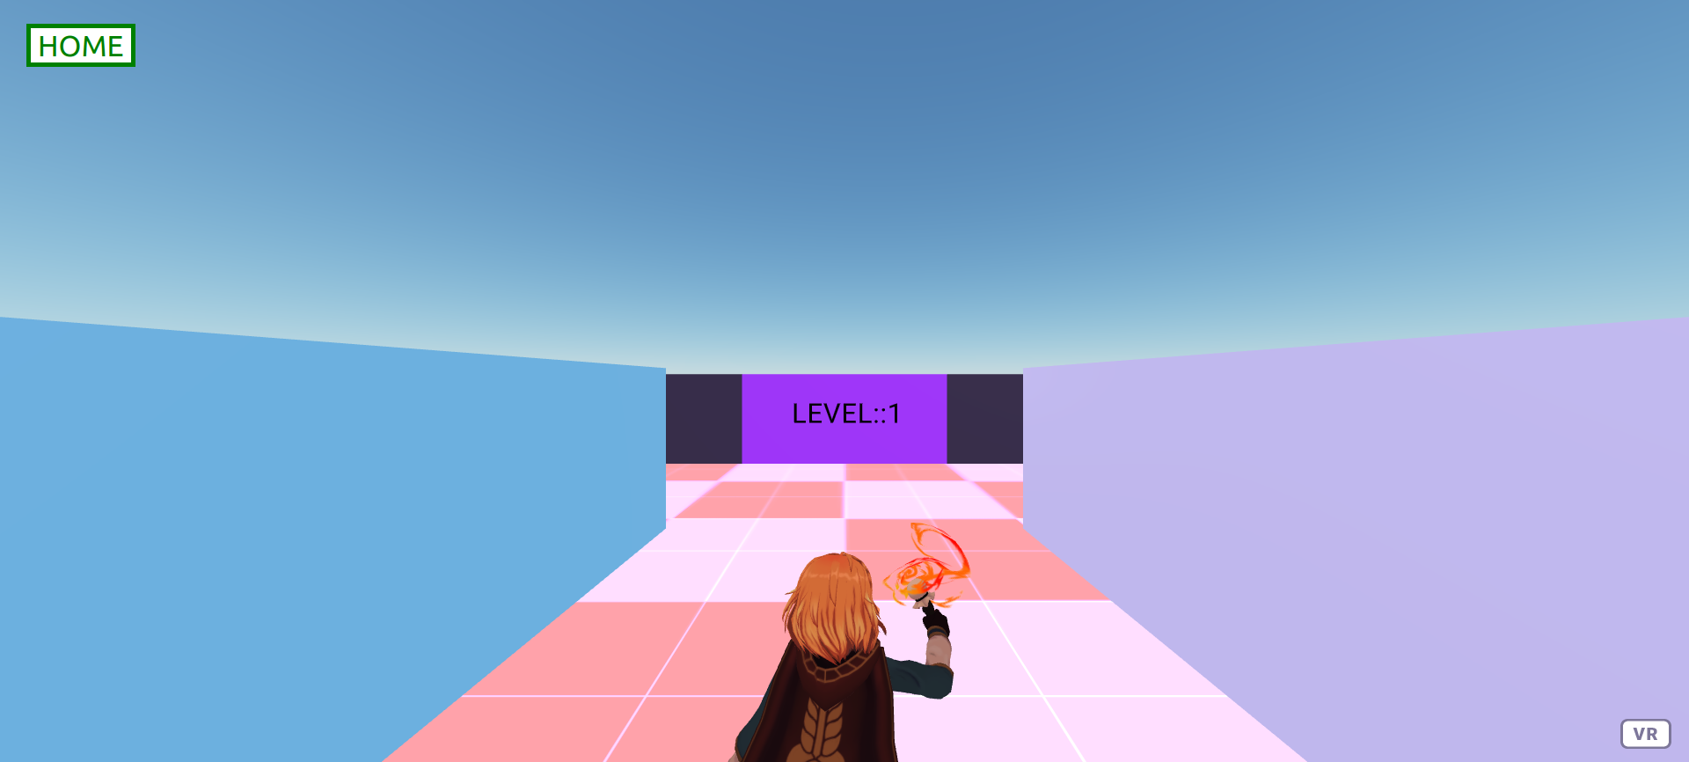
Notes:
<number>

Slide 10
WORK DISTRIBUTION

Slide 11
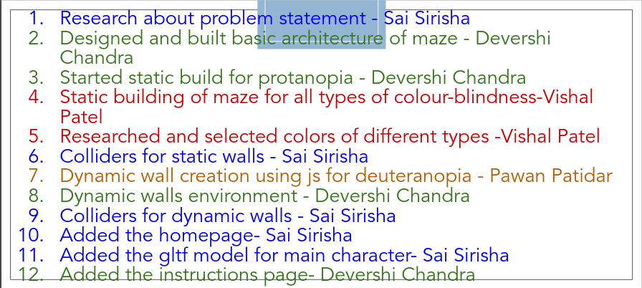
Notes:
<number>

Slide 12
PROBLEMS FACED & SHORTCOMINGS

Slide 13
SUBMISSION CHECKLIST

Slide 14
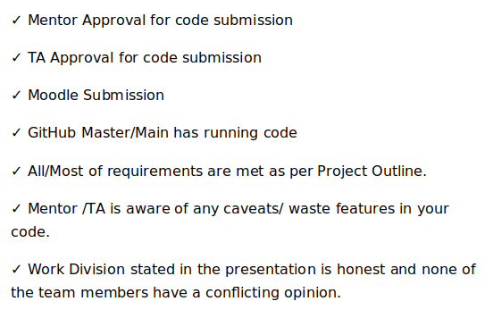
Notes:
<number>

Slide 15
LEARNINGS & TECHNOLOGIES USED

Slide 16
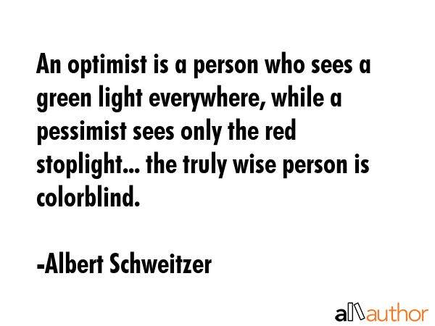
Enjoy the demo
Notes:
<number>

